Slide 1
Employing ReCON for Optical Wave Gauging with Deep Neural Networks in the Great Lakes Nearshore
Nicholas Catanzaro
Michigan State University, MI
Dr. Christopher Sherwood,
USGS Woods Hole Coastal and Marine Science Center
Data Provided by:
Dr. Steve Ruberg,
NOAA Great Lakes Environmental Research Laboratory

Slide 2
Acknowledgement
I am currently residing on and studying the land and waters of the Anishinabek Three Fires Confederacy tribes of the Ojibwe, Odawa, and Potawatomi, among other Indigenous peoples in Michigan and across the Great Lakes Region.

Slide 3
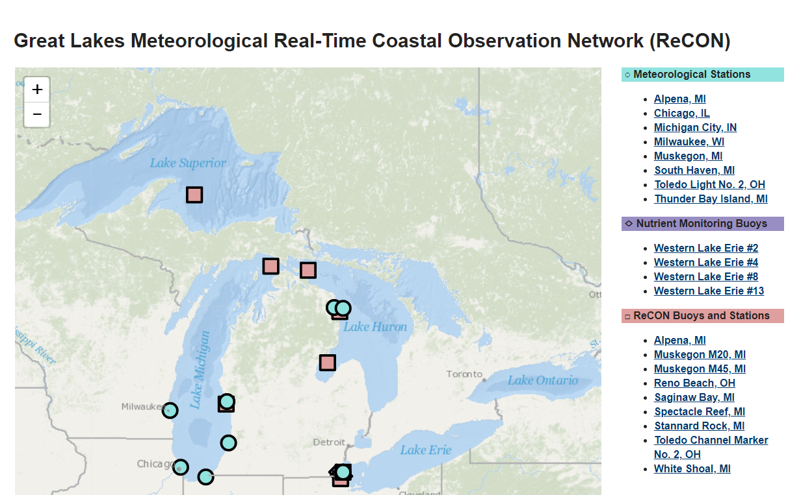
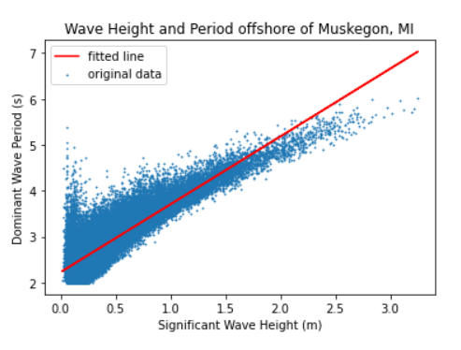
Quick Great Lakes Facts
Surface area: 94,250 mi²
Comprised of Lakes:
Superior
Michigan-Huron*
Erie
Ontario
Constitutes about 1/4 of the Earth’s surface freshwater
Waves are formed by local wind conditions
NOAA’s Great Lakes Environmental Research Lab (GLERL) maintains the Real Time Coastal Observation Network (ReCON) that collects images and meteorological data in 4/5 Great Lakes
*Hydrologically, Lakes Michigan and Huron are one lake as the 5 mile wide Straits of Mackinac allow for the flow of water between the two basins, holding water level at an equilibrium across the lake(s).

Slide 4
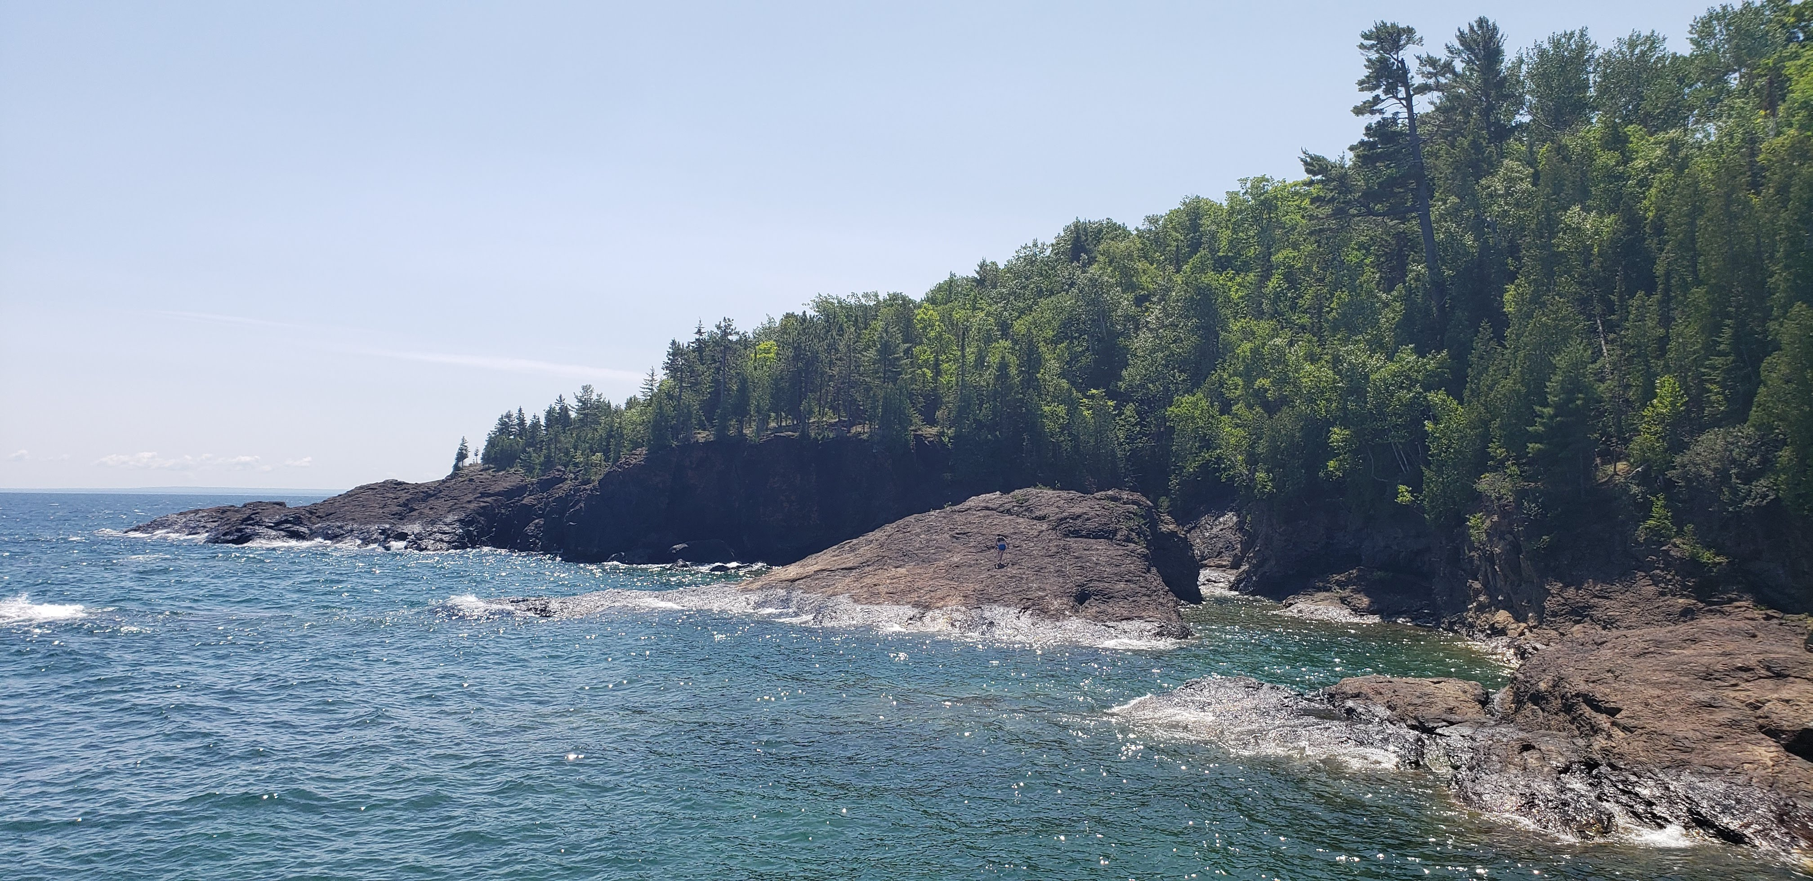
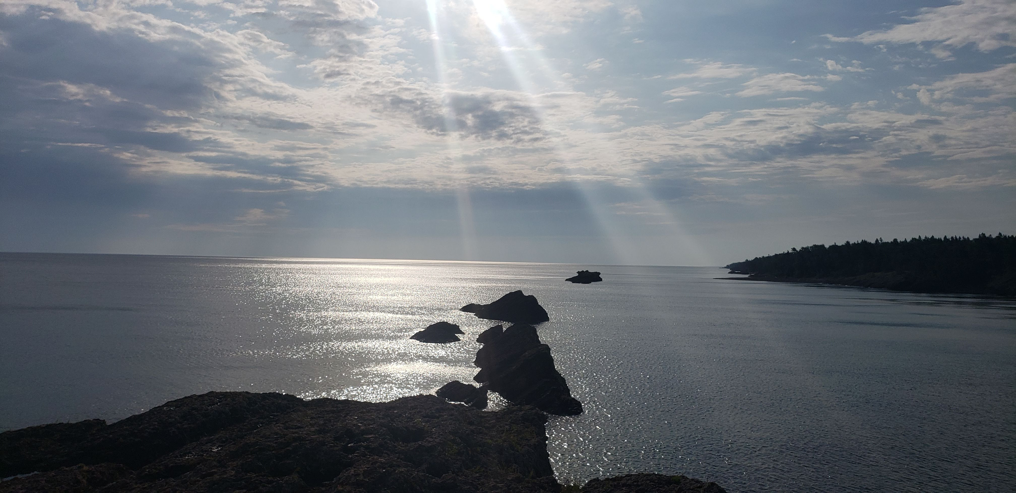
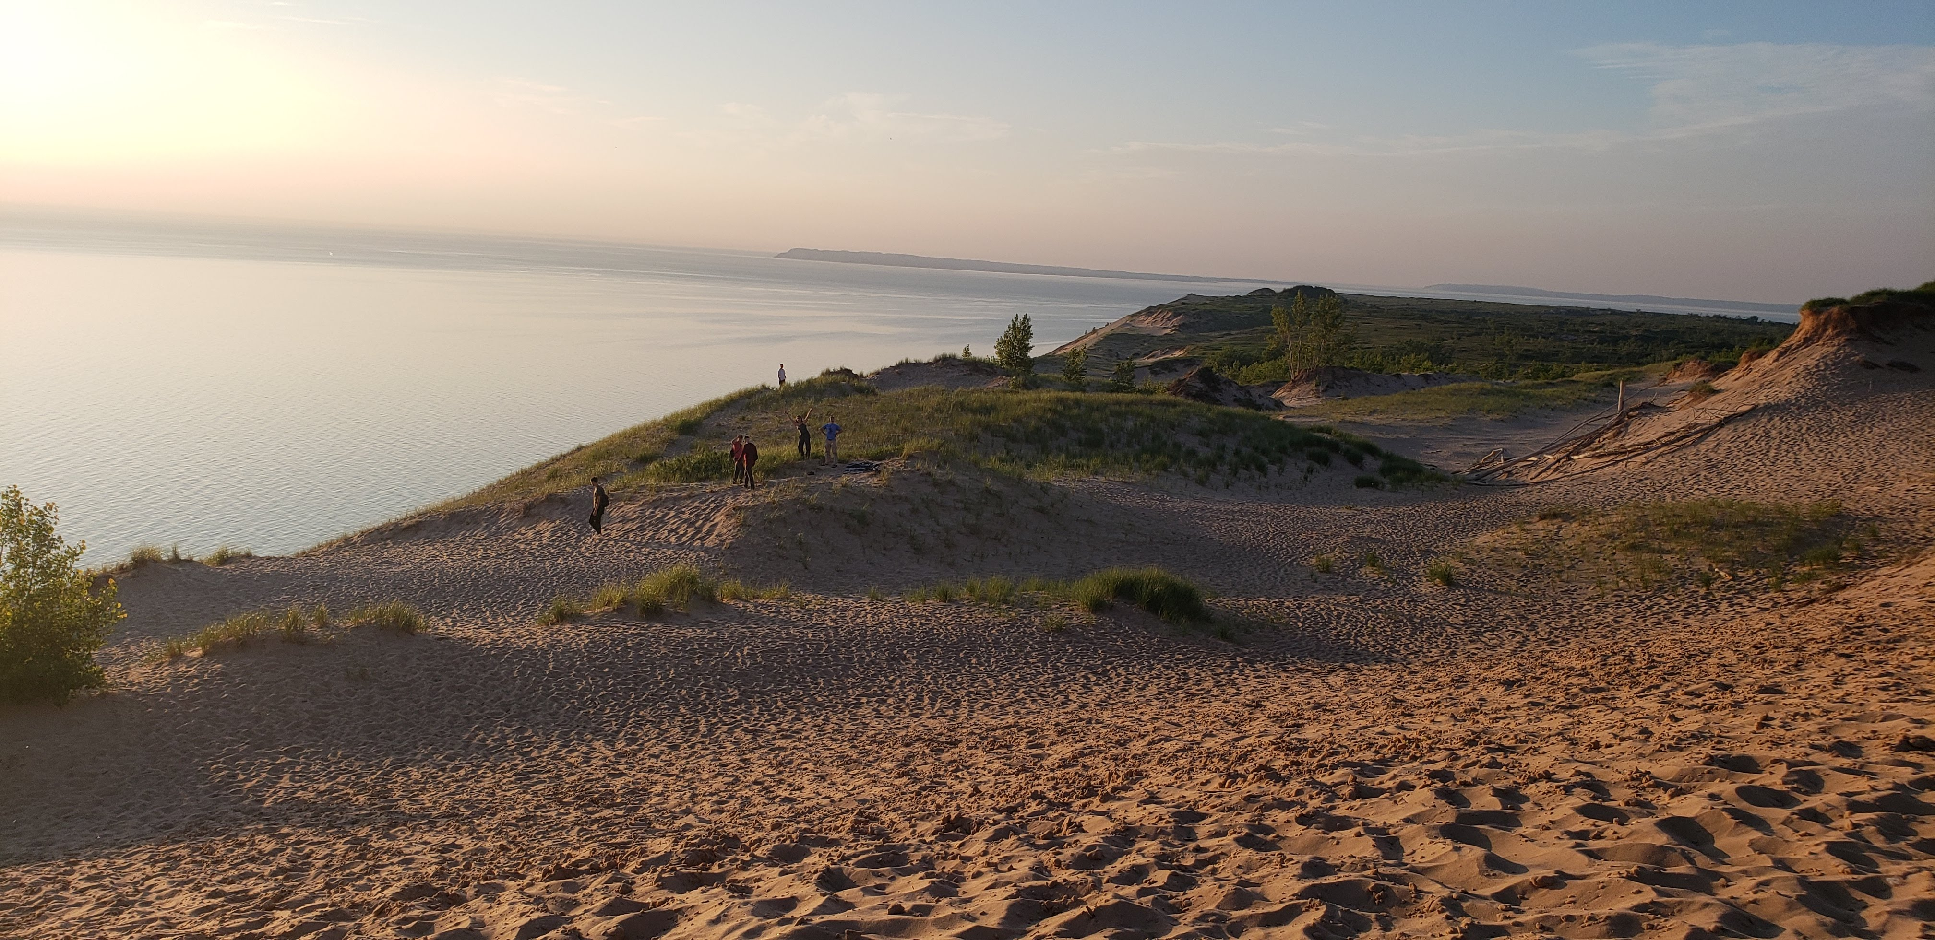
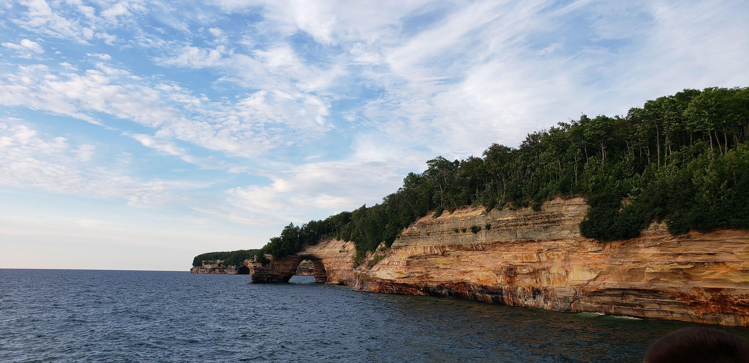
Coastal Variability in the Great Lakes
The coasts of the Great Lakes have large geomorphic variability due to the glacial history of the region.

Slide 5
Project Background
In situ wave sensing instrumentation in the Great Lakes is removed for several months to avoid damage from lake ice.
This creates a gap in the data during the significant period of time where buoy data is unavailable, but there is still open water on the lakes.
Quantifiable wave data is important to assess on the water safety conditions, predict coastal change, validate marine weather forecasting, and provide an input for numeric coastal change and hazard models.
Using machine learning, researchers have trained computer models to return wave height and period from nearshore imagery.

Slide 6
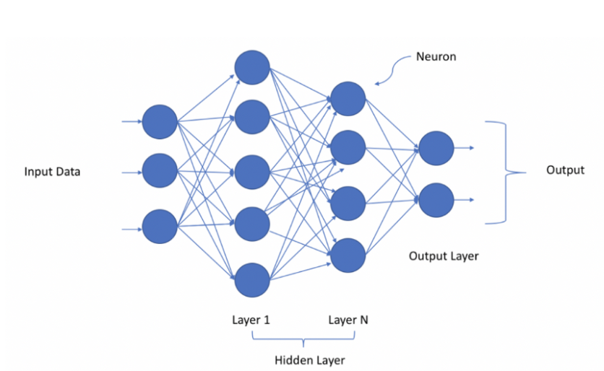
What is a deep neural network?
A deep neural network is a computer program based on the human brain
Deep neural networks can process inputs through multiple “hidden layers” before returning an output.
This summer, I am training an Optical Wave Gauge (OWG) to calculate the significant wave height and dominant wave period of an image (Buscombe et al., 2020)
tinyurl.com/kjnr7p5c

Slide 7
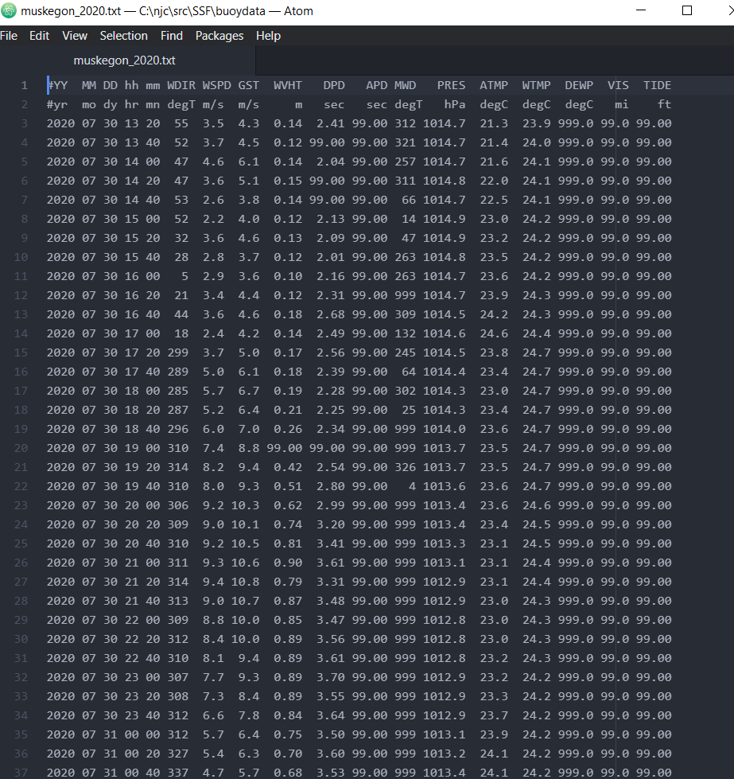
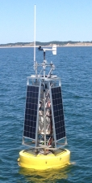
Training Data-ReCON Buoys
tinyurl.com/sah2bdf6

Slide 8
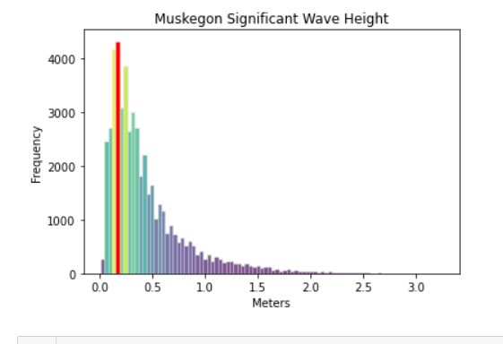
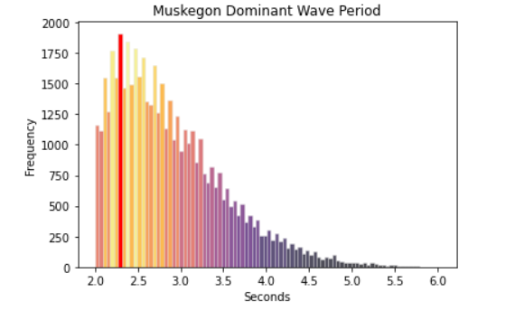
Training Data-ReCON Buoys
Significant Wave Height: The mean wave height of the highest 1/3rd of waves during the sampling period
Dominant Wave Period: Also known as the “peak period”, this is the period with the highest wave energy, which is always either swell or wind-waves

Slide 9
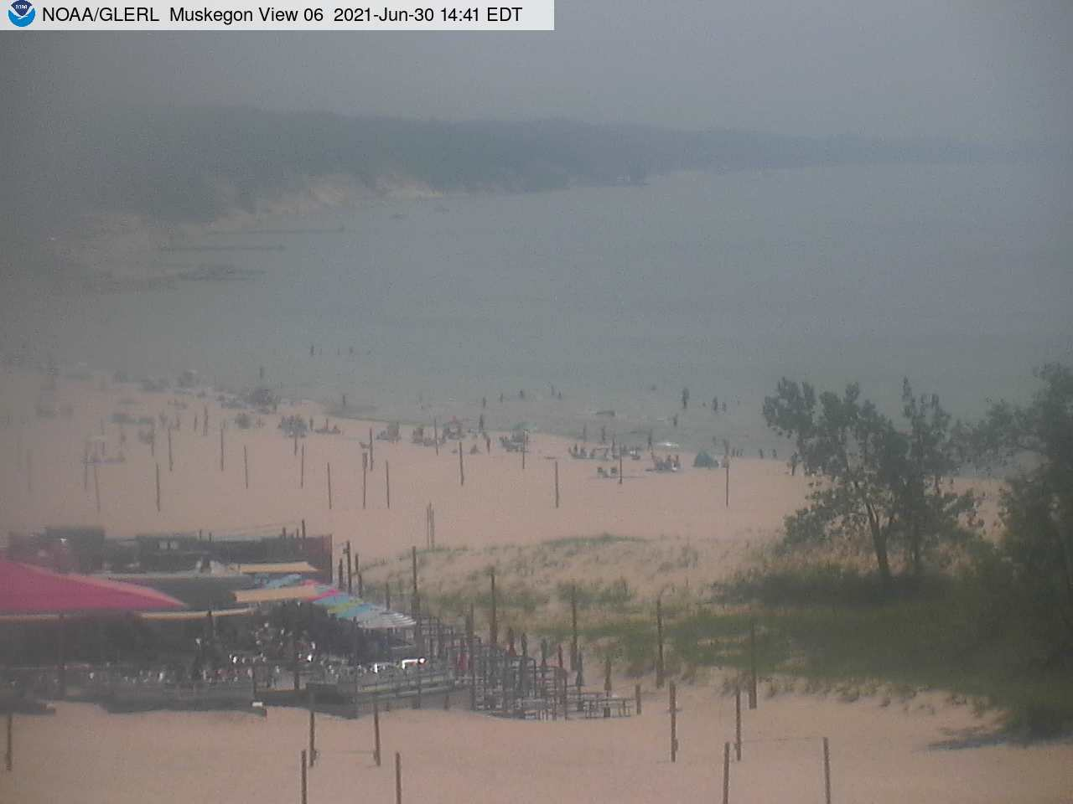
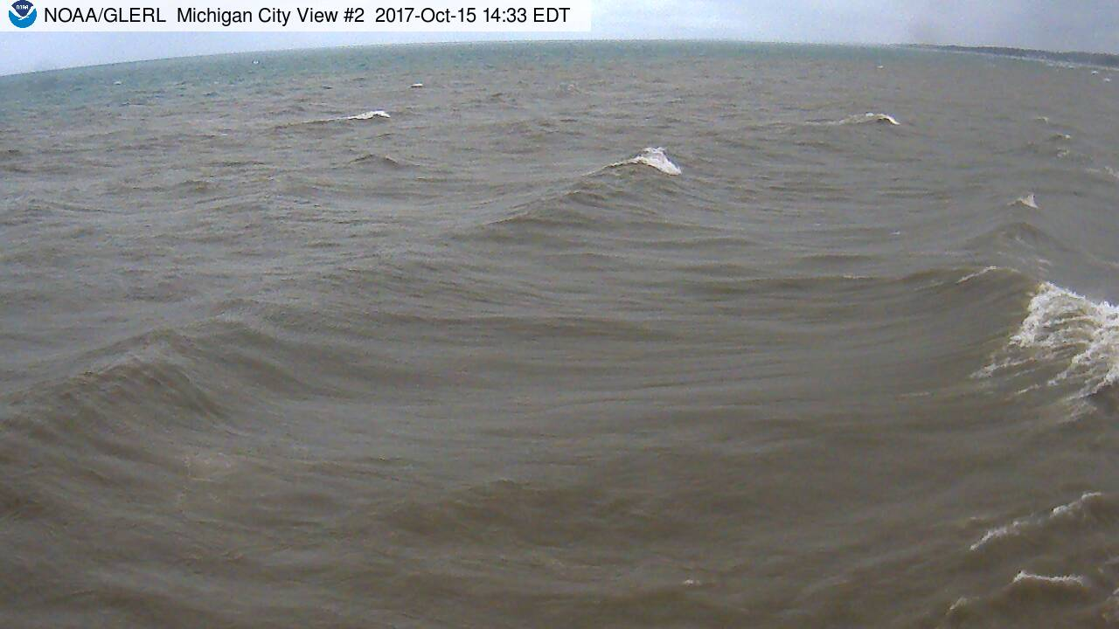
Training Data-ReCON Webcams

Slide 10
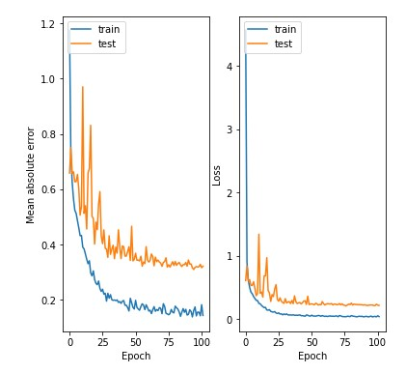
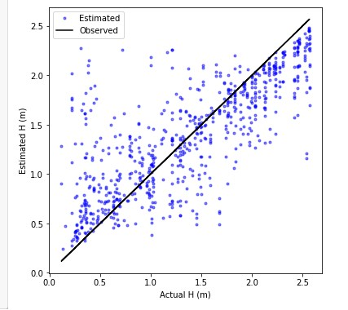
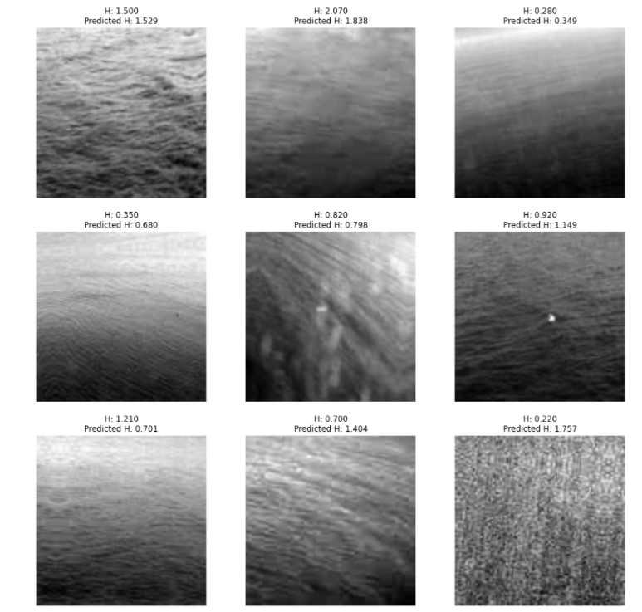
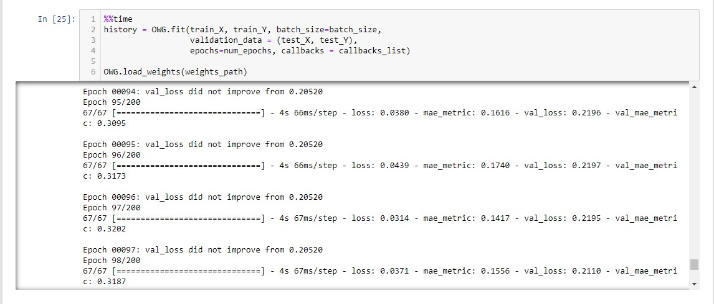
Initial Results of the model

Slide 11
Future Directions
Collaborate with the GLERL Observation Systems & Advanced Technology team to make the OWG available to researchers.
Implement a “cascading model” system to account for changes in Great Lakes water level.
Automate a method to filter through images to increase the accuracy of results.

Slide 12
Works Cited
Daniel Buscombe, Roxanne J. Carini, Shawn R. Harrison, C. Chris Chickadel, Jonathan A. Warrick, Optical wave gauging using deep neural networks, Coastal Engineering, Volume 155,2020,103593,ISSN 0378-3839, https://doi.org/10.1016/j.coastaleng.2019.103593.
(https://www.sciencedirect.com/science/article/pii/S0378383919301243)

